Slide 1
The traditional cooperative way haloumi cheese was made from goat milk in the neighborhoods of Cypriot villages in the 1960’s.
The need for producing haloumi cheese from goat milk in the villages.
Goats as milk - and meat - producing animals in Cyprus.
The neighborhood cooperative spirit and how this evolved.
The main stages of haloumi production: from the milking of goats to the production and ripening of haloumi.
The preparation of the space, the necessary tools and equipment, commodities and other materials.
The curdling of milk and the production of haloumi and anari cheese.
Preservation, storage and maturation of haloumi cheese.

Slide 3
A written document on how haloumi cheese was produced dating back to 1643 Γεωπονικό, Αγάπιος Κρήτης Παύλου Θ. Ιωάννου, Φιλελεύθερος
<when you curdle the milk to make haloumi and then anari cheese, you first take the settled curd out of the copper container after you have broken the freshly made raw curd cheese into small pieces making sure it is not too solid,…. You then cut it into small pieces of about four ounces each and you then return it back in the whey liquid in the copper container…. The pieces of the raw haloumi will sack down the base of the container….. And you then light the fire under the container to heat the liquid once again, and when you see them rising on the surface of the liquid after they have been heated for some time, take them out of the liquid using a draining ladle and place them in an appropriate bowl container. You then take them one at a time and you fold them over and over again five or six times provided you do not burn yourself …. And you then put them folded as they are in an earthen container, piling them up one over the other making sure you have salted them enough….with as much salt you know is needed, making sure they are not too salty and can not be eaten, neither under salty and develop a foul smell…. >

Slide 5
Ελληνικά ήθη και έθιμα στην Κύπρο Magda Ohnefalsch-Richter, 1913 μετάφραση Άννα Μαραγκού
……. The following main dish served to us really had an excellent taste. That was the traditional village sausages made from pork meat, fried in olive oil and pork lard together with eggs. With these there were also served slices of halloumi cheese fried separately but served together as accompaniments. The author commented that the fried halloumi had a much nicer taste than the raw one. A sweet soft cheese called anari, served cold, flavoured with aromatic honey and spread with rose water.

Slide 7
How haloumi was made: Nitsa’s case study
Making haloumi can be a laborious activity that needs a lot of concentration, co-ordination, collaboration and hard work. You must be the mistress of the place, and an active member of the haloumi making community of your neighbourhood; and still it is always possible that all this may not be enough. It is always possible to fail in making good haloumi, and then ….. I can not imagine so much work I have put, so much effort, so much milk and other ingredients and expenses and money…. I do not really want it to be wasted, so much effort and pride, to be wasted, I can not imagine this !!! What am I going to say, what excuses could I find?

Slide 9
What efforts and what kind and how much work
It all begins with the selection of the goat(s)
Accommodating, feeding and caring for them
When the time comes mating , pregnancy and appropriate care
Good feeding, cleaning and protective environment
Moving around in the country side, obtaining a variety of natural feed plus fresh air
Helping out during birth-giving and milk feeding the baby goats
Caring for the baby goats until they can feed themselves with natural food and grass
Termination of milk feedingΘηλασμός
Milk production period

Slide 10
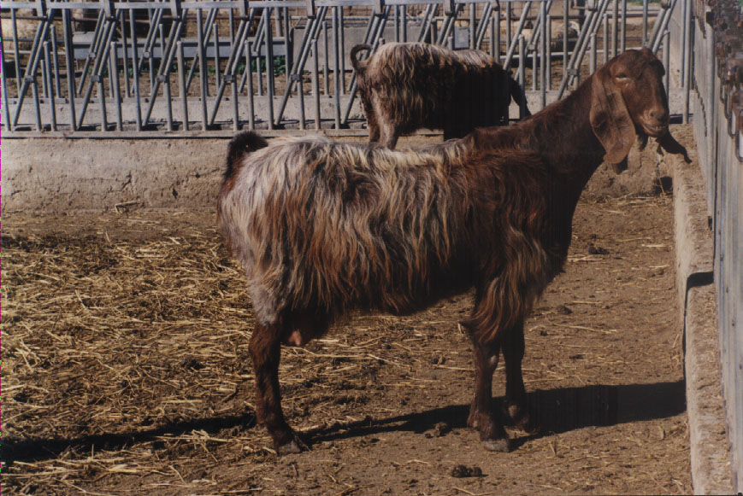

Slide 11
To collect enough milk you need to have a cooperative spirit, be friendly and trustworthy
Making friendly company in village neighborhoods
The women's decisive role; many responsibilities
Nitsa and her neighborhoods company – parea
Her Mentors
The preparation, the utensils, the materials and the method
Good feeding and goat caring means good production of milk
The transfer and delivery of milk

Slide 13
I found my group and I was ready to begin making my haloumi in my own house
<So I found the group of women with whom I was going to collaborate. But my experience until then was only based on observations of how to make haloumi. I never made it myself. Now the time had come! During the first year, when I was making my haloumi at a friend's house, my mother used to come and help me whenever I was making halloumi.
In the second year however, when I decided to make it in my own house, my mother was not very happy in coming to help me so early in the morning, every day. So I called my aunt Maria, my mother's sister who used to live in a nearby town to come and give me a hand. I was getting on very well with her and when I requested her help she was glad to provide it. Don't worry, my daughter, she said, I will be there early in the morning.>

Slide 15
Good preparation: the secret of my success
I consciously worked out everything I needed days before.
All necessary tools and equipment, materials and commodities, were in my mind; making haloumi was a challenge for me I had to win.
Equipment such as the hartzi, (the big copper container in which milk was curdled), the tiroskamnos (a small table on which both haloumi and anari curds were placed in sequence, after their removal from the copper container wrapped and drained), were taken out of my store room and properly cleaned to be ready for use
The milk measuring containers, a cane stick with a small brunch of throumbi fix at the end of it, for steering the milk, the drained ladle for the safe removal of the curd from the copper container.

Slide 17
Tools and ingredients
The cloth in which the haloumi and anari curd will be wrapped, pressed and drained.
A piece of flat wood called sanidi to be placed on top of the wrapped curd, making sure an even flat surface will be given to it;
The sieromili and a rather heavy stone for pressing the curd;
A tsestos to cover the hardji to keep away any dust or smoke;
The cooking nest had to be ready for lighting with small pieces of wood and throumbi, for heating and curdling the milk.
Collecting the ingredients and setting up the tools and the workplace were a vital first step. While knowledge of the procedure could easily be picked up by simply watching others, the actual skill of making haloumi could only be acquired by becoming actively involved in the production process.

Slide 19
The day has come…..
<When my aunt came and saw all the preparations I made, her face was shining. I could see how proud she was for me. I was very proud of her too. She was my aunt to whom I could turn to whenever I needed help and she was a master lady for making haloumi>.
<Early in the morning all the women from my group started coming bringing the milk they collected. Milking of the goats was done twice, early in the evening the night before, about an hour after sunset. Since there were no refrigerators in the house, milk was safely kept outside, hanged about two - and - a - half meters above the ground and covered. The second milking was done early next morning (the day haloumi was to be made) just before sunrise. The two lots of milk were mixed under the best possible hygienic conditions and immediately delivered to the lady who was collecting milk to make haloumi.
<Milk was measured and empty in the copper container, above the cooking nest. All together the total amount of milk provided by all women was about 65 – 70 lts of milk daily. Within half an hour all fifteen of them came and brought their milk>.

Slide 21
Nitsa‘s recollections the first time she made halloumi with her aunt: The curdling of milk
My aunt Maria was ready, <come on> she said, <let's start>. She washed herself and I gave her a clean towel to dry her hands. <Let‘s Iight the fire>. Only a small fire was needed, we just wanted to lookwarm the milk. After a few minutes, as the milk was warming up, we diluted the curdling powder in a glass of fresh milk and poured it in the milk in the copper vessel (the hardji) that was warming up. We let the fire go off and we then covered the vessel with a clean piece of white cloth and over it we put the tsestos to keep it tight. At this point the miracle was beginning to take place.
We waited for about 45 minutes. We had the chance to sit down for a while, have a coffee and talk about all the work that was ahead. Time passed quickly and at the right time aunt Maria approached the vessel and uncovered it. She pushed the curd with her fingers from the sides of the vessel and the curd was easily separated from its walls.

Slide 23
The breaking of haloumi curd
<It is ready, my dear>, she said. She looked at the curd once again and very decisively made the move. <Light the fire>, she said. A small fire was needed to keep the curd warm. She made the sign of the Cross on the surface of the curd, which was called "yiali, which means "the glass"."Come, Jesus Christ and Virgin Mary, give us a hand, help us," she whispered and she immediately started breaking the curd into pieces. This allowed the curd to separate from the liquid. All the curd was broken into small pieces and was left to sink down to the bottom of the vessel. It was left there "to sleep" for about fifteen minutes. The vessel was covered with a tsestos and we waited for the right time to come".
After about 15 minutes she uncovered the vessel and she carefully removed all the broken curd from the vessel by using both her hands. The broken curd was transferred to the small table (tiroskamnos) and placed on the white tummy cloth on the giros. The curd was further broken and pressed to let the liquid out of the mass of the curd. As the liquid passes out the curd was wrapped in the white tummy cloth and was given a round circular shape facilitated with the wooden giros - the circle when translated into english. On the wrapped haloumi curd a thin flat wood was placed to give to it a flat shape. A sheromily stone was placed and on top of it another rather heavy stone to press any excess whey liquid, which passed out. This whey liquid was collected in a container to be used later. The wrapped and pressed haloumi curd was kept under pressure for about one hour.
During this hour anari, the so called whey cheese, was to be produced.

Slide 25
The production of Anari
While the drosino, that is the haloumi curd, was pressed to release any excess liquid and to attained a more solid shape, it was the right time to make anari. In the whey that was left after the haloumi curd was removed, 2 lts. of that days milk together with the liquid pressed out from the haloumi curd, were added to the vessel and a good fire under the vessel was lighted. I was steering the liquid to prevent the anari from sticking on the base of the container. While anari is being prepared, it is time to open – unwrapped, the haloumi curd. Everything placed over it is removed and very carefully the wrapping cloth is also removed. The shining curd is now sitting on the tiroskamnos and aunt Maria cut it into the normal size haloumi pieces, of about 350 g each.
All the pieces were placed in a clean container and the surface of tiroskamnos was again clean and ready to accommodate the anari curd in the same way as this was done with the haloumi curd. This time however the anari curd was removed from the vessel using a draining ladle because the anari curd was burning hot. The anari curd was therefore removed from the vessel and placed over the cloth in the circular wooden tool called giros so that the whey liquid was gradually drained away. The anari curd was then wrapped up and the flat wood was placed over it; the total weight that was put on top of it was about half of the weight placed on top of the haloumi curd.

Slide 27
While anari is on the table waiting for the excess liquid to drain off, more wood is placed under the vessel to heat the liquid in which the fresh haloumi will be boiled. When the liquid is almost at boiling point the fresh haloumi is added to the vessel. This is a very critical point for the whole operation. The raw haloumi should go deep down to the base of the vessel and stay down for about 20 minutes, while the whey liquid is heated up and boiled gently. In case the raw haloumi stays on the surface, without going down to the base, it is very bad news - not only for the family but for the whole group. It means that the haloumi is spoiled and is no good for human consumption. At this time there is a lot of anxiety for the lady making haloumi because if the haloumi is no good it means that all this effort, and raw materials have been wasted. Having put the raw haloumi in the hot liquid and assuming they have gone down to the bottom of the vessel, as expected, heating with a good fire continues for about 20 minutes. During boiling, haloumi is gently steered with a drained ladle to prevent it from sticking on the base of the vessel. After heating it for the right time haloumi cheese starts rising on the surface of the liquid. Gentle boiling continues for another 15 minutes, turning it over from time to time, making sure that it is cooked evenly on both sides. When haloumi is gently boiled on the surface it is spread with a little cold water every 2 – 3 minutes. Over-cooking gives a deeper yellow colour to haloumi and should be avoided.

Slide 29
In the meantime the required amount of whey liquid from the anari curd is drained away, anari curd can be now divided into equal portions. Anari curd is unwrapped and cut into uniform square pieces of about 350 g each. They are then placed over a tray and are lightly salted and flavored with dry mint. This mint flavoring is optional. Anari cheese may be consumed fresh with little or no salt added to it, or it may be salted and dried for tatter use.
The tiroskamnos surface is now free, it is cleaned and ready to accommodate the just boiled haloumi, which is removed from the hartzi vessel and placed on the tiroskamnos.

Slide 31
Haloumi is then salted on all sides, and dried mint may be added for flavoring (optional). Haloumi is then folded into two’s and keep it aside, until is completely cooled down. It is then placed in layers in a glass or earthen container, pressing them lightly to fill up all the space in the container and also maintain its shape. Two pieces of cane sticks, in the shape of cross, are used to press and held the haloumi inside the bottle/container. Hot whey liquid, slightly salted and minted, is added to fill up the container making sure all the haloumi is completely covered with whey liquid. The jars are very carefully sealed as tightly as possible so no air is allowed to get inside the jar. The jars are then put aside to cool down and then transferred to a cool and hygienic environment usually in the house cellar.

Slide 32
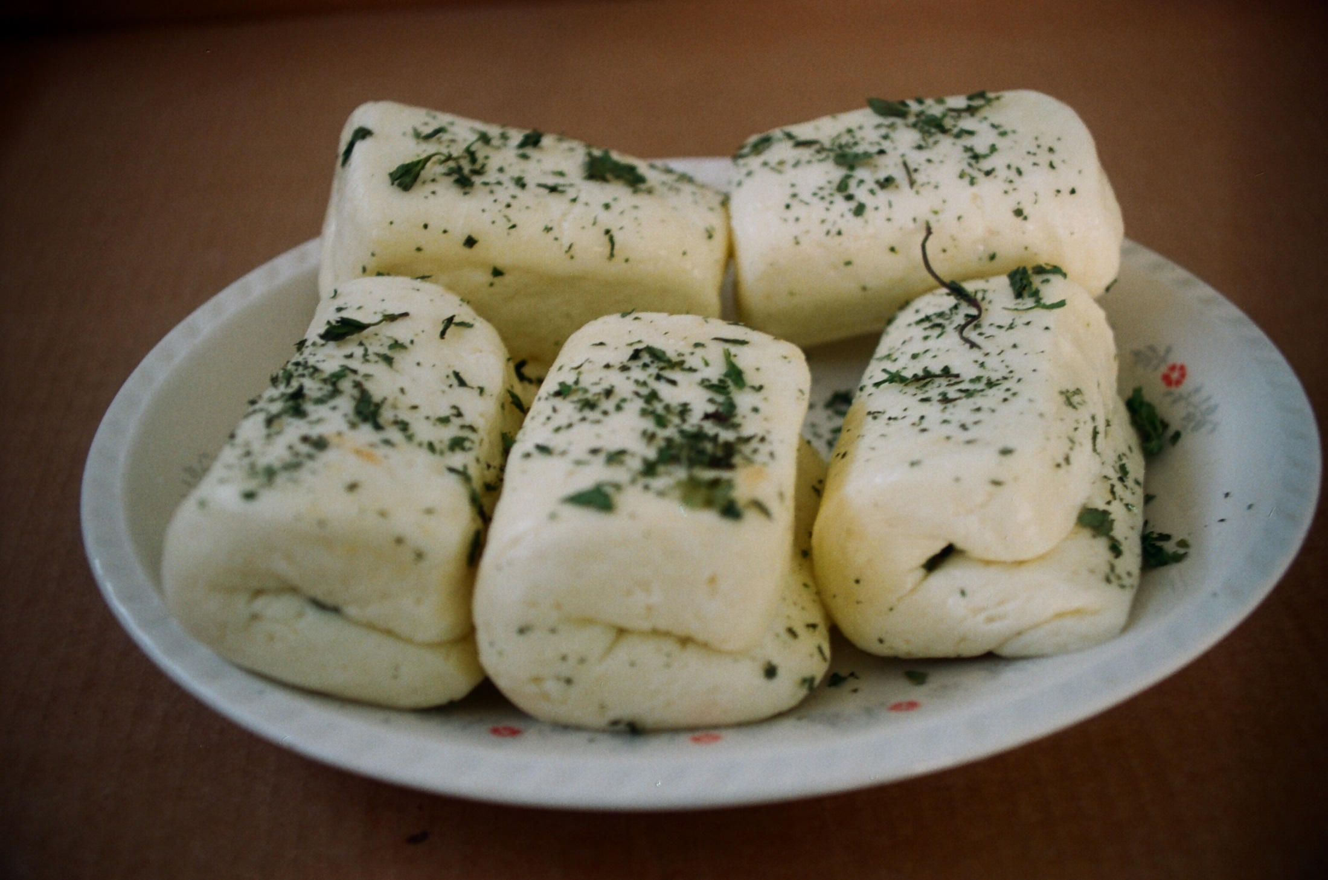

Slide 34
The 40 days maturation process of haloumi, 'the removal of the disease'
Haloumi is now entering the final stage towards completion, that is the maturation process or posarantoma, or xiarostima.
This involves the opening of the container twice or tree times per week and the removal of the fat that has risen on the top surface of the whey liquid in the container.

Slide 36
The 40 days maturation process of haloumi, 'the removal of the disease'
The container is then refilled with whey liquid which was kept from the previous day.
This treatment continues for the following six weeks (forty days to be accurate), twice or three times per week. This activity is called posarantoma and it literally means the forty days that have elapsed since the first day haloumi was produced.
After the forty days period haloumi is completely matured and is ready for consumption. It will be stored in the jars, in the cellar it will be the main supply of haloumi for the family for many weeks or even months.

Slide 37
